Slide 1
UNIVERSITY ADMISSION SYSTEM
PROJECT MEMBERS
S.PREMA RAJU
M.AADARSH
V.ROOBINI
SHEEBA
K.GANESH
SELVAPRIYA
JEEVITHA
SUBHA SREE
N.BHARGAV RAMA RAJU

Slide 2
CONTENTS
1 Introduction
1.1 Abstract of the project
1.2 Functional components of the project
1.3 Technology to use
2 Implementation in JEE LOT
2.1 Guidelines on the functionality to be built
2.2 Evaluation and assessment parameters

Slide 3
ABSTRACT OF THE PROJECT
This project is aimed at developing a University Admission System (UAS) for applicants. This system can be used to search a university program for which an applicant wishes to take admission; apply for a selected university program without any login and fill up the form, administration staff can add/update/delete any program that university offers. Members of admission committee have the responsibility to filter the candidates for a specific program on the basis of application data and interview. There are features like report generators etc in this system.

Slide 4
Functional components of the project
There are three categories of people who would access the system viz. applicants, members of admission committee (mac) and administrators. Each one of them would have some exclusive privileges (for e.g. Applicants can apply for a program by filling up the form without any login process, members of admission committee alone will be able to view applicant details and filter the applicants for a specific program they have applied for and only the administrator has the right to keep track of the university’s program details.)

Slide 5
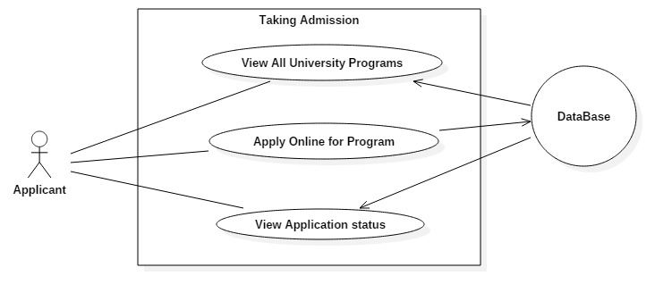
Applicant should be able to
• View all programs scheduled by the university
• Apply online for a scheduled program of the university, by filling up the application form that
auto generates the application ID
• View the application status, based on the application ID

Slide 6
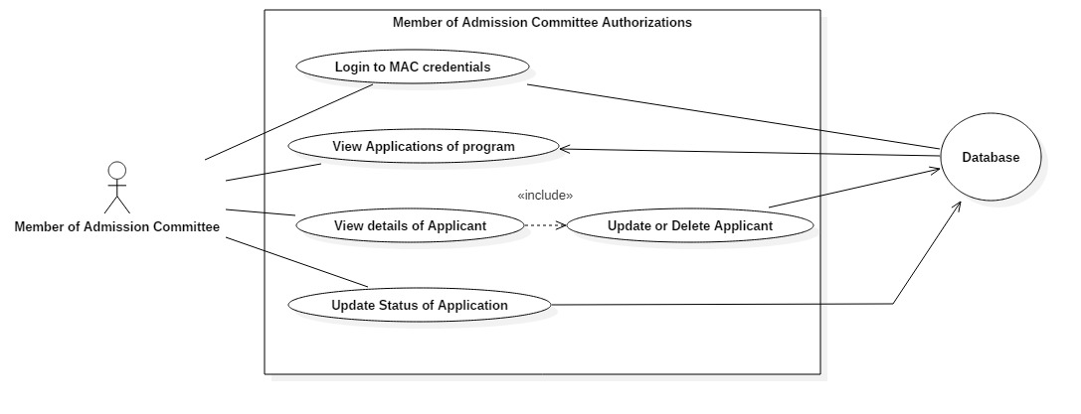
2. The member of admission committee (mac) should be able to :
• Login into the system using his/her credentials.
• View applications for a specific program.
• Accept/Reject an application on the basis of the details of the applicant. If accepted, fill in the
scheduled date for an interview of the applicant before confirming the applicant to take the program.
• After the interview, update the status of the application to Confirmed/Rejected

Slide 7
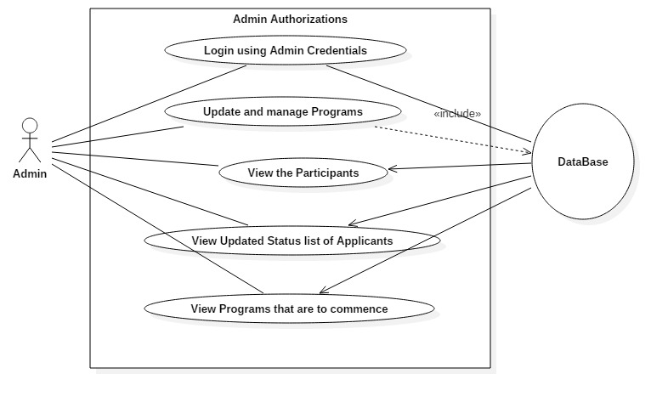
3. The administration should be able to
• login to the system using his/her credentials
• Update and manage (add or delete) information of the programs offer by the university
• Manage (add or delete) schedules of the programs offered by the university

Slide 8
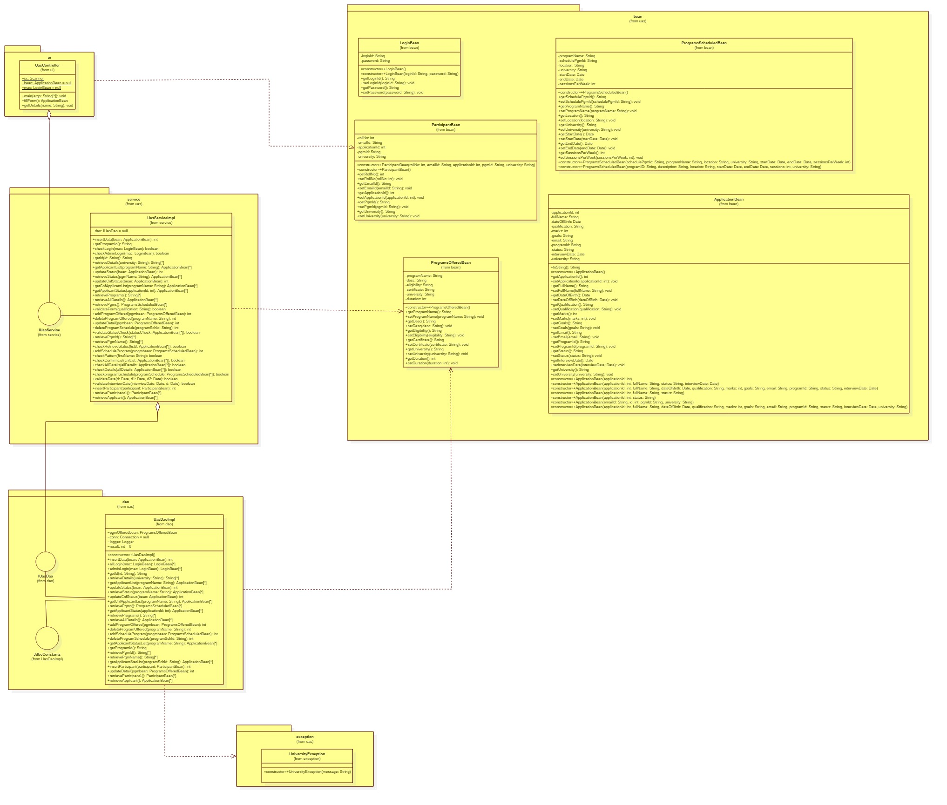
Class Diagram

Slide 9
Technology to use
Front End & Web Components:–
Java Classes would be designed for this Purpose.
Business Logic Components and Services :-
Java Beans
Databases:-
Oracle 9i

Slide 10
GUIDELINES ON THE FUNCTIONALITY TO BE BUILT:
1. Course: Core Java 8 & Development Tools
Developing Business components (java classes). Coding for test classes & testing the functionality using JUnit
2. Course: Oracle
Creating relevant database tables
3. Course: OOP & UML
Creating relevant Use case and class diagrams

